Slide 1


Slide 2


VENN DIAGRAMS

Slide 3
Concepts:
Venn diagrams are an efficient way of representing and analyzing sets and
performing set operations.
Sets are generally represented by circles.
The universal set is represented by a rectangle that encloses all other sets.
∪ is Union: is in either set or both sets
∩ is Intersection: only in both sets
− is Difference: in one set but not the other

Slide 4
Question 01:
In a group of persons travelling in a bus, 6 persons can speak Tamil, 15 can speak Hindi and 6 can speak Gujarati. In that group, none can speak any other language. If 2 persons in the group can speak two languages and one person can speak all the three languages, then how many persons are there in the group ?
A. 21
B. 22
C. 23
D. 24
Answer: C

Slide 5
Explanation:
Let us assume the two persons who can speak two languages speak Hindi and Tamil. The third person then speaks all the three languages.
Tamil – Number of persons who can speak is 6. Only Tamil 6 – 2 – 1 = 3
Hindi - Number of persons who can speak is 15. Only Hindi 15 – 2 – 1 12
Gujarati – Number of persons who can speak is 6. Only Gujarati 6 – 1 = 5
Thus the number of persons who can speak only one language is 3 + 12 + 5 = 20
Number of persons who can speak two languages = 2
Number of person who an speak all the languages = 1
Total number of persons = 23.

Slide 6
Question 02:
In a town of 500 people, 285 read Hindu, 212 read Indian Express, 127 read Times of India, 20 read Hindu and Times of India and 29 read Hindu and Indian Express, 35 read Times of India and Indian express and 50 read no news paper, then how many read only one paper ?
123
231
312
321
Answer: D

Slide 7
Explanation:
No. of people who read Hindu = 285 No. of people who read TOI = 127 No. of people who read IE = 212 Now, No. of people who read Hindu and TOI both is = 20 No. of people who read TOI and IE both is = 35 No. of people who read Hindu and IE both is = 29 Let No. of people who read Hindu , TOI and IE all is = x ; So, only Hindu is = 285-20-29-x = 236-x ; Only TOI is = 127-20-35-x = 72-x ; Only IE is = 212-35-29-x = 148-x ;Now, 236-x + 72-x + 148-x + 20 + 29 + 35 + x + 50 = 500 590 -2x = 500 x = 45 this is the value who read all the 3 dailies. No. of people who read only one paper is = 236-45 + 72-45 + 148-45 = 191 + 27 + 103 = 321.

Slide 8
Question 03:
Out of 120 students in a school, 5% can play all the three games Cricket, Chess and Carrom. If so happens that the number of players who can play any and only two games is 30. The number of students who can play the Cricket alone is 40. What is the total number of those who can play Chess alone or Carrom alone ?
A. 45
B. 44
C. 46
D. 24
Answer: B

Slide 9
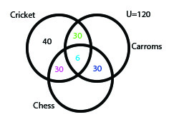
Explanation:
Given U=120
5% of 120 = 6
Therefore, Students who can play Chess alone or Carroms alone = 120 - (30+40+6)= 44

Slide 10
Question 04:
Main street high school has 10 members on its football team and 14 members on its science club. 5 members at the school belong to both the football and science teams. How many students belong to only science club team or football team?
9
14
24
21
Answer: A

Slide 11
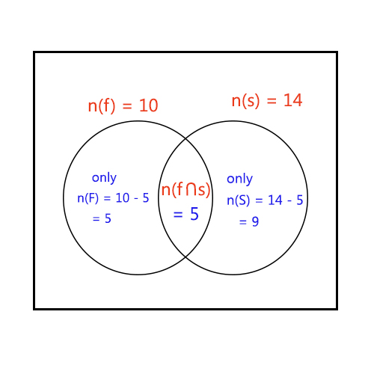
Explanation:
Given that,
Members in football team = n(f) = 10
Members in science club = n(s) = 14
Members in both football team and science club = n(f ^ s) = 5
Then, Members in only football team = n(F) = 10 - 5 = 5
Members in only science team = n(S) = 14 - 5 = 9
Hence, members in only football or science team
= n(FUS) = n(F) + n(S) - n(f^s)
= 9 + 5 - 5
= 9.
Hence, many students belong to only science club team or football team = 9.

Slide 12
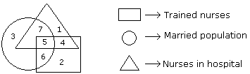
Directions to solve questions 05-09:
Study the following figure and answer the questions given below.

Slide 13
Question 05:
If hospital management requires only married trained nurses for operation theater, which part of diagram should be chosen by him?
A. 7
B. 4
C. 5
D. 6
Answer: C

Slide 14
Question 06:
By which number, married but untrained nurses in the hospital are
represented?
A. 4
B. 6
C. 7
D. 5
Answer: C

Slide 15
Question 07:
By which number, married but untrained nurses in the hospital are represented?
A. 4
B. 6
C. 7
D. 5
Answer: C

Slide 16
Question 08:
By which numbers trained nurses are represented?
A. 3, 6
B. 7, 5
C. 5, 6
D. 1, 5
Answer: C

Slide 17
Question 09:
By which number, the trained unmarried nurses in the hospital are
represented?
A. 6
B. 5
C. 7
D. 4
Answer: D

Slide 18
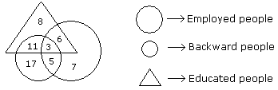
Directions to solve questions 10-13:
Study the following figure and answer the questions given below.

Slide 19
Question 10:
How many educated people are employed?
A. 9
B.18
C. 20
D. 15
Answer: A

Slide 20
Explanation:
Number of educated people who are employed = 3 + 6 = 9.

Slide 21
Question 11:
How many backward people are educated?
A. 9
B. 28
C. 14
D. 6
Answer: C

Slide 22
Explanation:
Number of backward people are who are educated = 11 + 3 = 14.

Slide 23
Question 12:
How many backward uneducated people are employed?
A. 14
B. 5
C. 7
D. 11
Answer: B

Slide 24
Question 13:
How many backward people are not educated?
A. 3
B.14
C. 22
D. 25
Answer: C

Slide 25
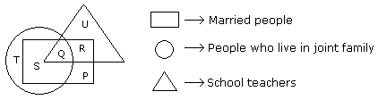
Directions to solve questions 14 & 15:
Study the following figure and answer the questions given below.

Slide 26
Question 14 :
By which letter, the married teachers who live in joint family are
represented?
A. R
B. Q
C. S
D. P
Answer: B

Slide 27
Question 15:
By which letter, the married people who live in joint family but not are
school teachers are represented?
A. R
B. U
C. S
D. P
Answer: C

